Slide 1
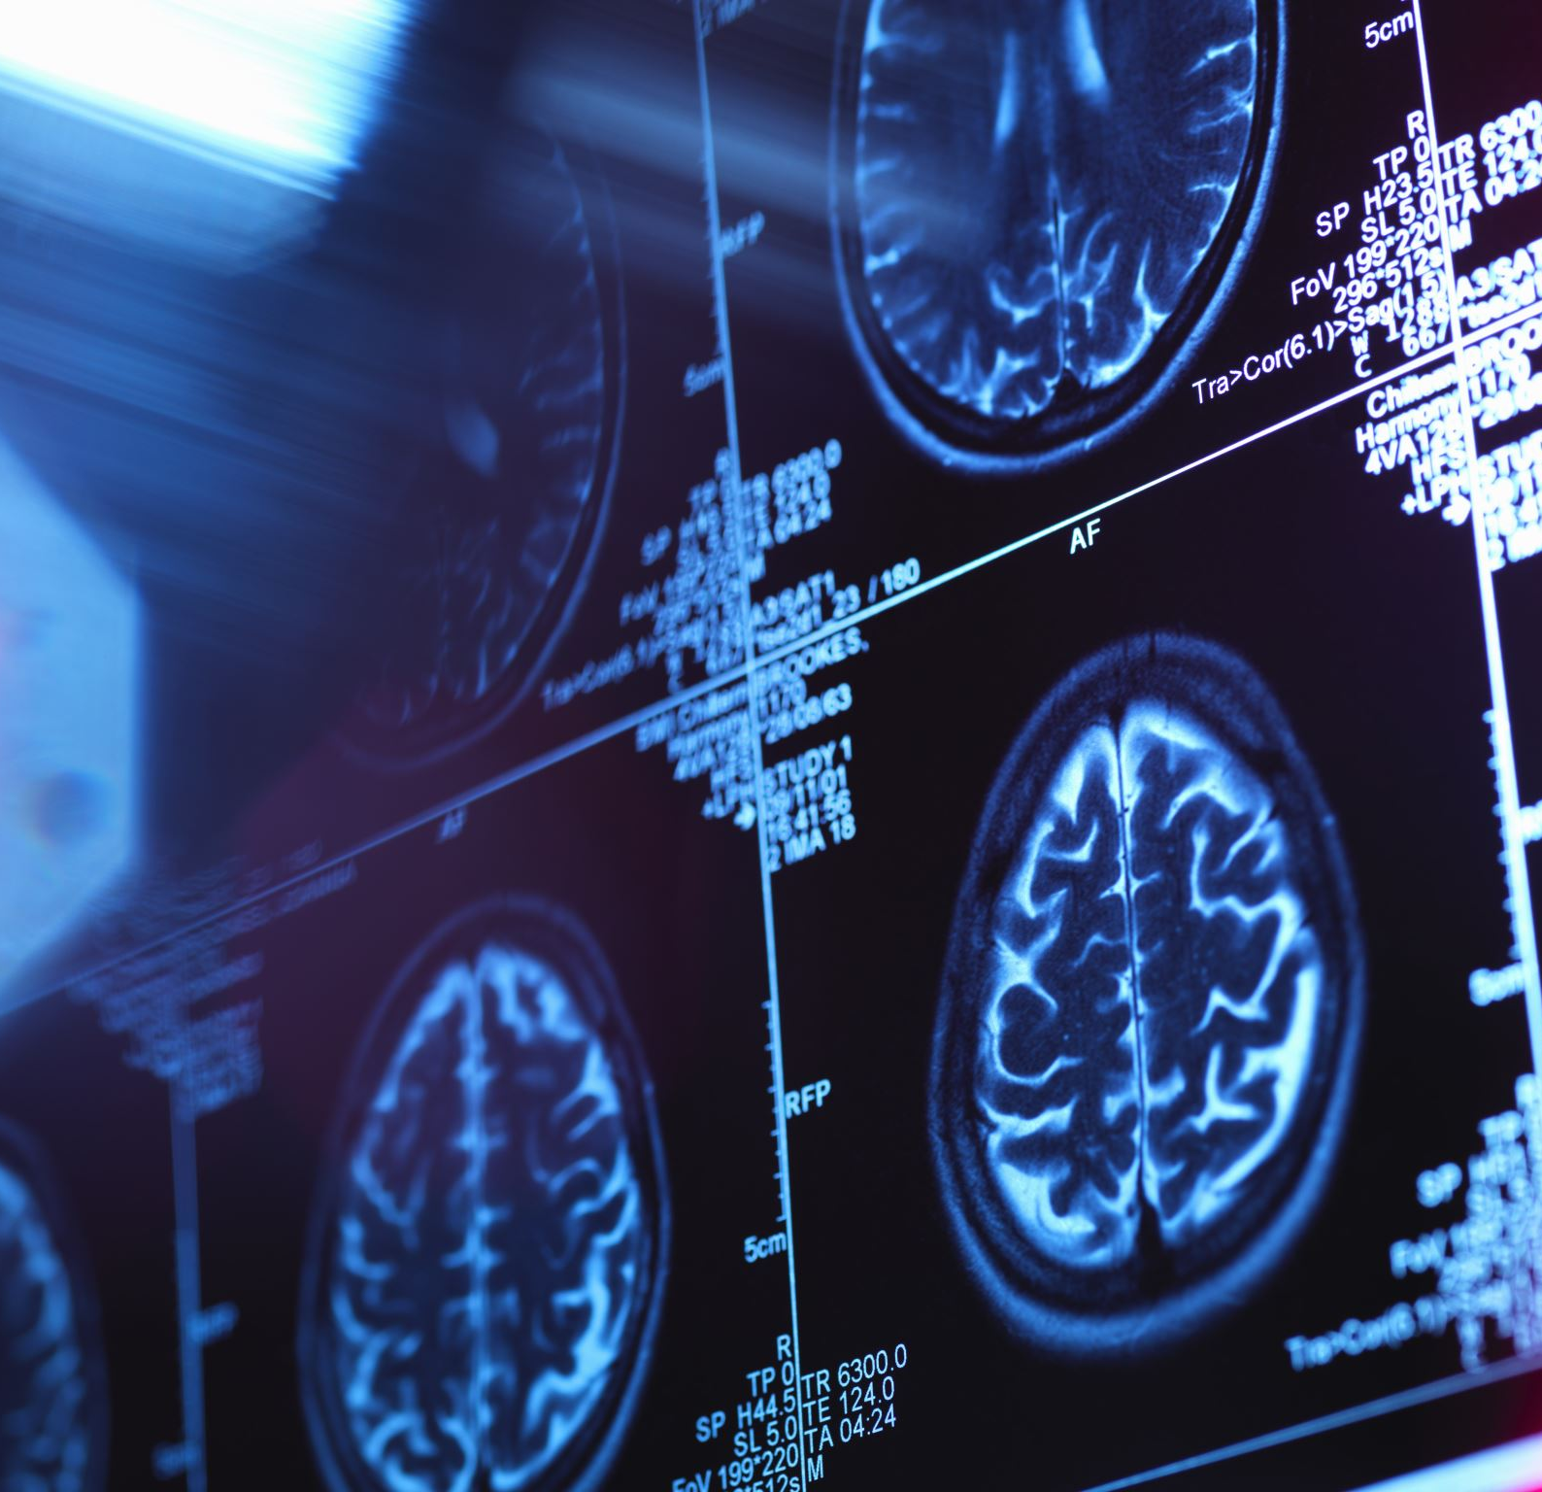
Psychological Theories of Crime
Tyler Poor

Slide 2
Main Idea
Criminal and deviant behavior is a direct result of a missing link between the normal development of the brain and the processes by which we learn new things.
This missing link can cause a multitude of unwarranted responses from individuals suffering from this issue.
Since this issue is so difficult to pinpoint, this can make diagnoses and remediations a hard task to accomplish.

Slide 3
Possible Causes
Failures in brain development
Learned behaviors of aggression
Inherent personality traits
Mental Illness

Slide 4
Three Major Psychological Theories
Psychodynamic Theory
Behavioral Theory
Cognitive Theory

Slide 5
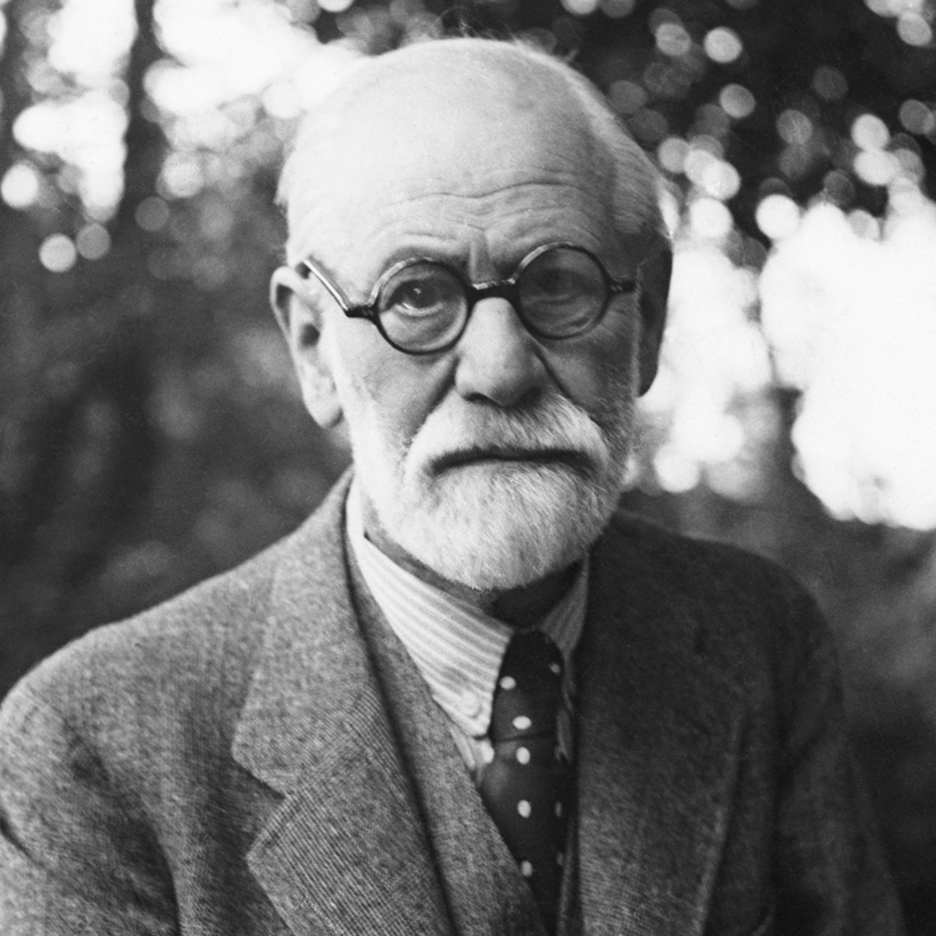
Psychodynamic Theory
Developed by Sigmund Freud
Claimed that an individual’s personality is controlled by a subconscious mental process that is grounded in the process of early childhood brain development.
Three Structures of the Human Personality:
The ID
The Ego
The Superego

Slide 6
The ID, The Ego, and The Superego
ID
Biologically driven attributes of an individual that includes needs like food, water, sex, and other necessities.
Ego
An attribute that develops early in life and compensates for the ID by guiding it into conformity within societal boundaries of behavioral expectations.
Superego
The attribute that focuses on morality and serves to pass judgement on the actions and behavioral intentions of individuals. It also tends to develop more as people grow and are influenced by those within their society and social environments.
The ego mediates between the id’s desire for instant gratification and the strict morality of the superego

Slide 7
The Connection
ID
“I want to do that now!”
Superego
“It’s not right to do that.”
ID
“Maybe we can compromise.”
Neutralization Theory

Slide 8
Negative Results of the Psychodynamic Theory
An underdeveloped superego, leading to an unawareness between right and wrong (social norms vs. non-social norms).
Mental Disorders
Conduct Disorders in Children
Oppositional Defiance in Children
Personality Disorders

Slide 9
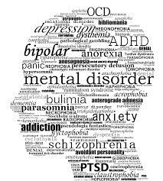
Mental Disorder Attributes and Causes
Mental Attributes
Depression
Rage
Social Isolation
Narcissism
Criminal Attributes
Fighting
Rape
Property Damage
Burglary
Murder
Causes
Brain Damage
Child Abuse
Genetics
Traumatic Events

Slide 10
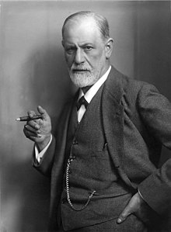
About Sigmund Freud
Born in Moravia, Austria.
He was an Austrian neurologists, psychologists, and criminologists.
Had a deep passion for helping those with mental illnesses and disorders to be understood by the normal population.
Conducted hundreds of case studies to help those suffering with mental illness.
Published the novel Criminality from a Sense of Guilt in 1916, that first introduced his psychoanalytic theory containing the ID, ego, and super ego.
Died at the age of 83 from cancer.

Slide 11
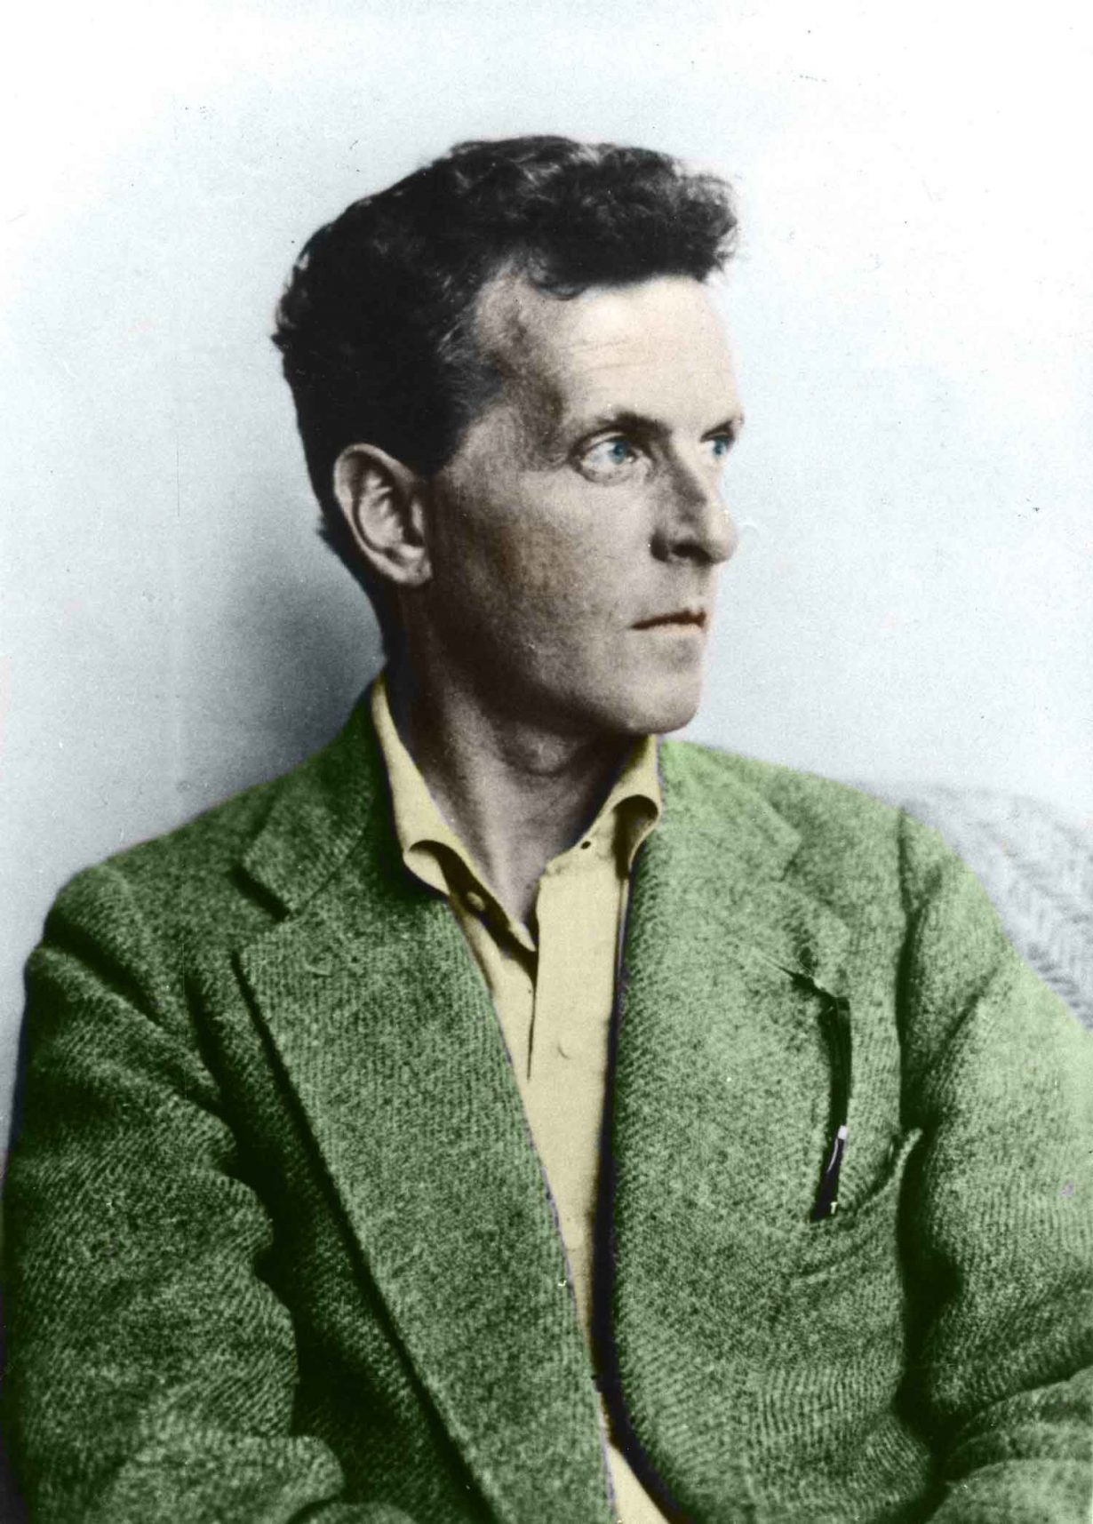
Psychodynamic Theory Criticism and Rebuttal
Criticism by Ludwig Wittgenstein, he claimed Freud “always had something to say”.
Did not understand why Freud dismissed biological possibilities as a causation of crime.
However, Freud was a secular realists, and sought to use logic and reasoning to complete his case studies and determine causation for crime and abnormal behavior.

Slide 12
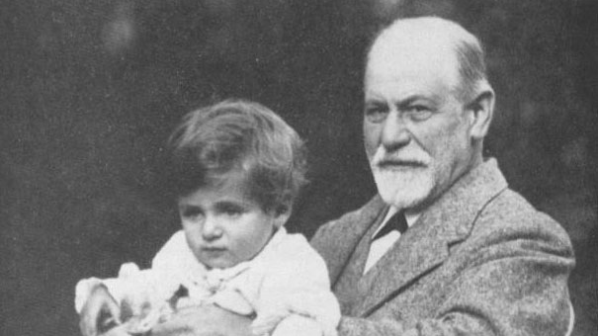
What is a case study?
In-depth research and study that focuses on interviewing the subject and those close within their societal environment.
Less constructive and routine-based as other methods of research.
More fluid and authentic.
Freud would observe his subject's behavior and their interactions with those in close relationships with them.
He would then document this raw data and organize it into consumable information that would build his case.

Slide 13
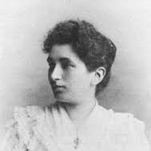
Emma Eckstein Case Study
In November of 1894, Freud conducted a case study on a young woman named Emma Eckstein
Emily was suffering from chronic gastro-intestinal pain and pain during her menstrual cycles.
A physician and close friend of Freud’s, Wilhelm Fleiss could not find an adequate cause for Eckstein’s issues.
However, after a long case study, Freud claimed that Eckstein’s problems were a direct relation to her past child-hood trauma of sexual abuse, which Freud called “the affect of fright”.

Slide 14
Psychodynamic Theory Conclusion
The Psychodynamic Theory developed by Freud, sought to find different ways to interpret cognitive behavior issues.
Through case studies and in-depth research, Freud was often able to find the cause of crime through past childhood trauma.
In most of his cases he drew back on the idea of the ID, ego, and superego, claiming that most of his subjects had an underdeveloped superego that led to their abnormal behavior or health issues

Slide 15
Three Major Psychological Theories
Psychodynamic Theory
Behavioral Theory
Cognitive Theory

Slide 16
Behavioral Theory
Developed by Gabriel Tarde
Claims that behavior and psychological reactions are based upon learned behavior from family, friends, the media, or society.
Main Points
Learned behaviors of aggression in children
Media Influence
Moral Responsibility and Laws of Imitation

Slide 17

Laws of Imitation
Tarde believed that as the brain began to develop and as the ego began to expand, developing individuals would begin to imitate those around them.
Most of the time those who were imitated were family members, and close friends.
Tarde saw this mostly in children imitating the actions of their parents.
Therefore, a common side effect for children within a toxic family environment would be mental disorders.

Slide 18
Moral Responsibility
Tarde also developed the idea of moral responsibility.
The claim was that all people actively dealt with individual identity and social similarity.
Individual identity
The concept of self.
The critique by the mind.
Social Similarity
The familiarity of self within society.
The comparison of the mind.

Slide 19
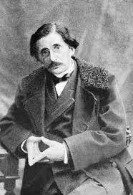
Tarde’s Effect on the Court and Prison System
Tarde realized a lack of education and awareness towards defendants suffering from psychological issues in the court rooms.
He proposed that a committee of psychologists and doctors be present during the times of the trial that would help resolve the issues via a psychological basis.
Tarde also argued for “conditional liberty” programs for prisoners in order to foster good behavior from them
They would be rewarded for good behavior.
Rewards would include more free time, more frequent visitors, and sometimes decrease in sentences.

Slide 20
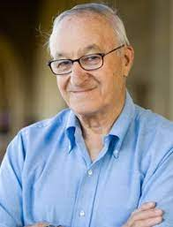
Albert Bandura
Believed that individuals were not born with the innate desire to commit crime.
Believed that people who live in more crime-ridden areas are more prone to mimic the environment around them.
Because of this, these individuals do not link with Tarde’s moral responsibility concept.

Slide 21

Bandura’s Focus on the Media
According to Bandura, one of the biggest influences in the Behavioral Theory is the media.
This can include pop culture stars, professional athletes, movies, video games, and news stations.
Being exposed to negative influences through the media will cause the superego to deteriorate and the individual's moral responsibility will deteriorate as well.

Slide 22
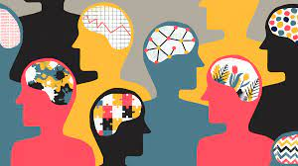
Desensitization
Behavioral Theory claims that desensitization can cause people to lose their sense of morality.
Not only this, but desensitization can lead to abnormal reactions from someone with a mental disorder, when they are faced with an overwhelming amount of stimuli.
Claims that desensitization is caused by an increase in negative influences in a person’s environment, often times from the media.

Slide 23
Three Major Psychological Theories
Psychodynamic Theory
Behavioral Theory
Cognitive Theory

Slide 24
Cognitive Theory
Developed by Wilhelm Wundt and William James
Focuses on understanding the “normal” brain processes of someone suffering with a major mental disorder (MMD) and how they compare to someone without an MMD.
Main Points
Moral Development Branch
Information Processing

Slide 25
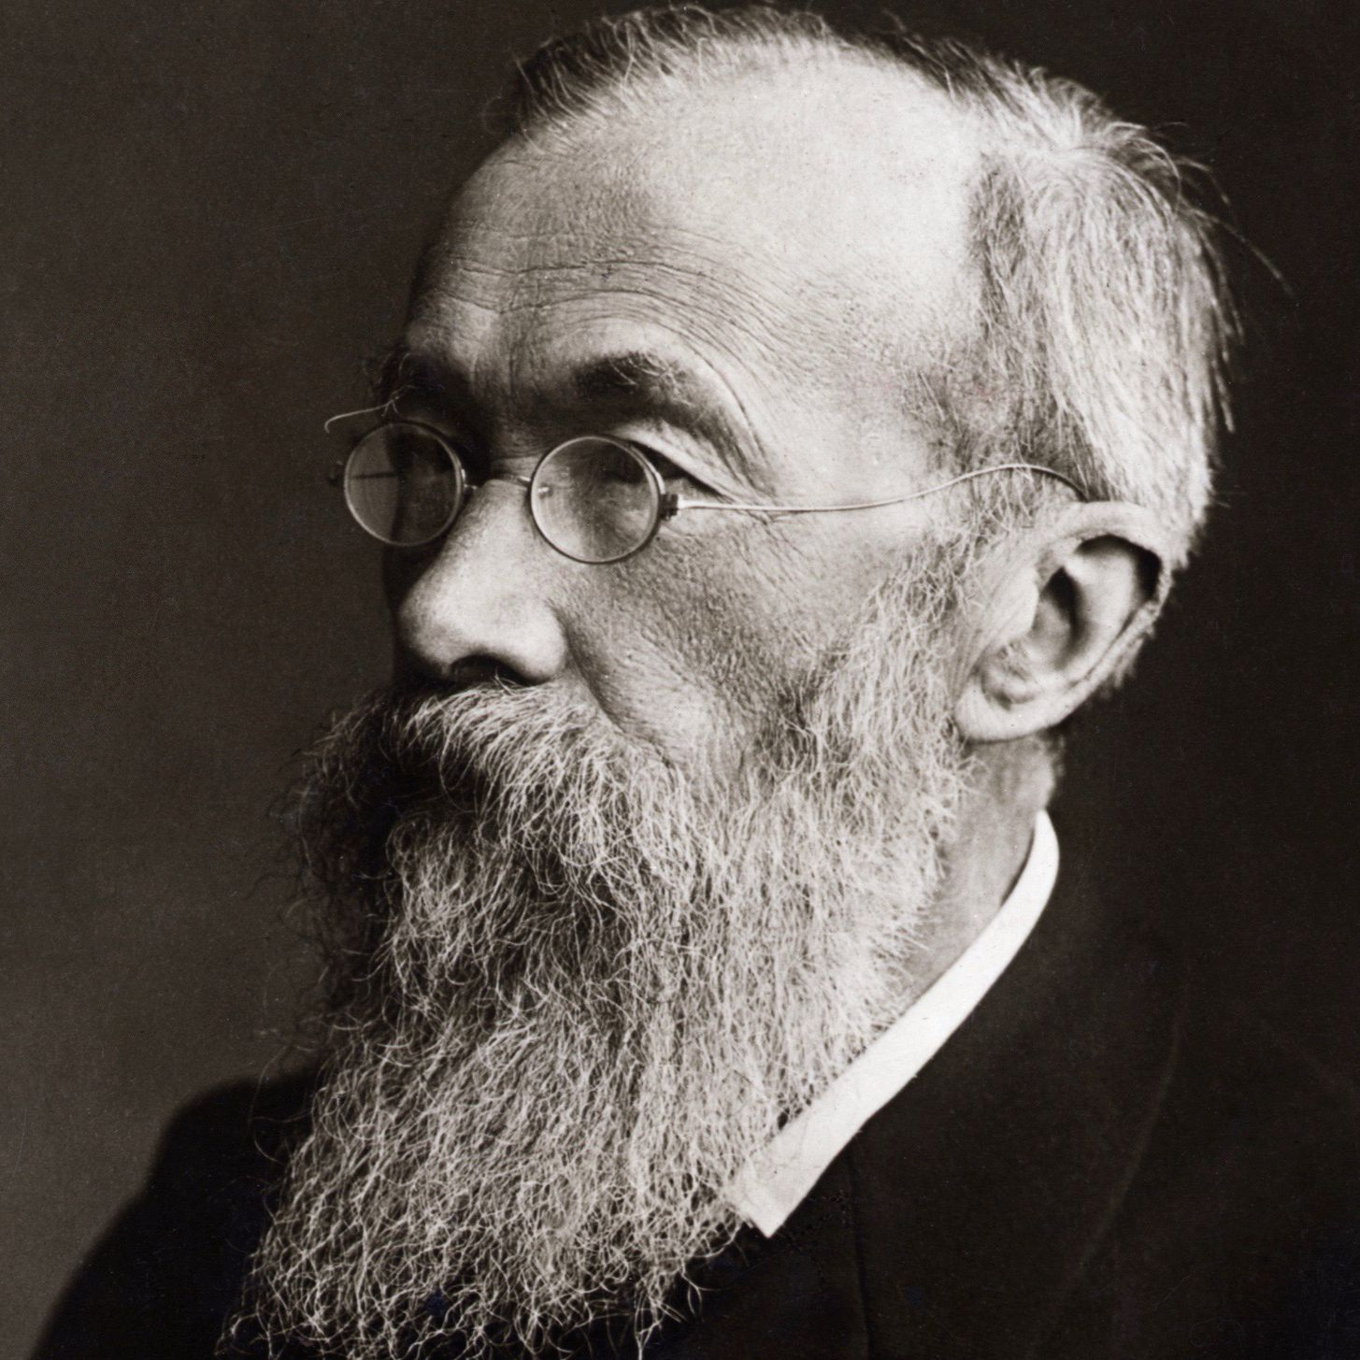
Wundt’s Focus
Wundt sought to conceptualize the importance of psychological perception and recognition.
Wundt focused on evaluating the “higher mental processes” among individuals.
Moral Development Branch
Information Processing

Slide 26

Moral Development Branch
Goes hand and hand with Freud’s ego concept.
States that as individuals begin to grow, they start to learn right from wrong, some quicker than others, and some not at all.
The problem occurs when individuals do not continue through the cycle causing a hindrance in mental and moral development.

Slide 27

Lawrence Kohlberg’s Six Steps of Moral Development
Punishments and compliance
- At a young age individuals are taught right from wrong and are challenged to accept those truths.
Recognition of Societal Boundaries
- The individual recognizes societal expectations towards behavior.
Belief of Societal Standards
- The individual believes these standards are plausible and real.
Adherence to Societal Standards – (Most Important)
- The individual starts to follow and be compliant with these standards of behavior.
Social Contract
- The individual begins to compare societal rules with individual liberties. This is the beginning of the compromise from the ego.
Principled Conscious
- The individual compares the truth of laws to their recognition and respect for humanitarian issues.

Slide 28
Information Processing
Claims that those who correctly gather, store, and react to information are less likely to be prone to an MMD than those who do not.
Steps:
Retrieval of the Information
Understanding of the Information
Storage of the Information
Reaction to Information
The process happens in less than a second, and those who have the “missing link” in brain development may respond in a way that can seem abnormal or deviant.

Slide 29
Common Behavior of MMD Patients
Antisocial
Charm
No Guilt
High IQ
Manipulative
Impulsive
Ego-centric
Lack of Emotion

Slide 30
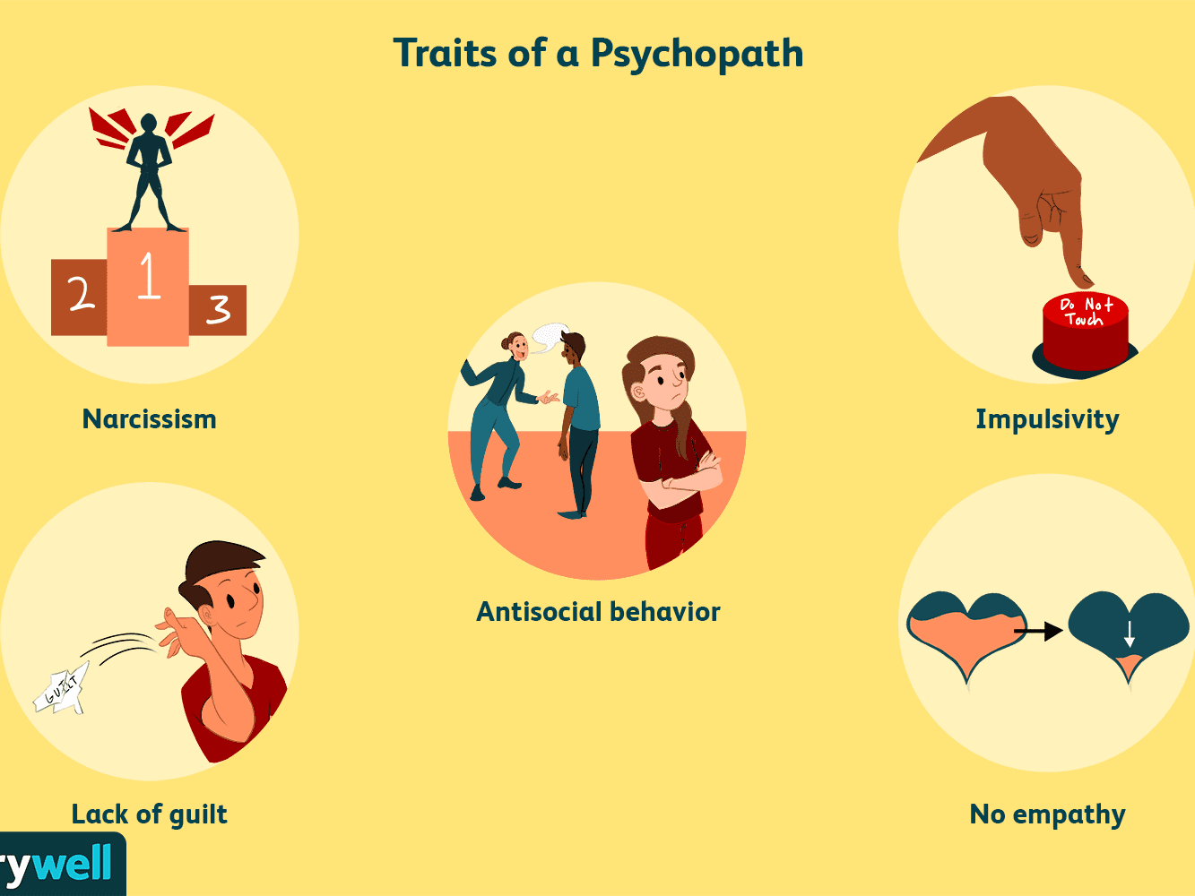
Causes for Psychopathic Behavior
Low levels of neurological engagement
Child-hood traumatic events
Genetics
Children interacting with psychopathic parents
Lack of discipline during the moral development process

Slide 31
Remediations to Psychological Issues
Community Care Programs
Long-term Care
Less-expensive than other options (hospitalization)
Stops re-offense rates for convicted felons with MMDs.
Helps MMD patients learn new skills and develop them.
Shows MMD patients how to rightly act within a functional society; teaching them to all work together towards a common goal.
Psychotherapy
Private
Group-based
Public Education Towards Psychological Issues
Teaching the public how to see signs of MMD and react to them accordingly.
Help families create a nurturing environment that fosters brain development.

Slide 32
Conclusion
Psychodynamic Theory
Using childhood past and personality structure to find causes for psychological issues.
Behavioral Theory
Psychological issues caused by imitation.
Cognitive Theory
Psychological issues caused by faulty brain processes.
Mitigation Strategies
Healthy Family Environment
Psychotherapy
Community Care Programs
If these remediations are adhered to and taken seriously, a decrease in criminal like behavior from mentally unstable individuals will occur.

Slide 33
References
Baldwin, M., Marques, L., Chablani-Medley, A., Schiraldi, V., Valentine, S., & Zeira, Y. (2018). Cognitive Behavioral Theory, Young Adults, and Community Corrections: Pathways for Innovation
Bloom, H. (2006, May 05). Why freud matters. Wall Street Journal Retrieved from http://mendel.csuniv.edu/login?url=https://www.proquest.com/newspapers/why-freud-matters/docview/398961150/se-2?accountid=26960
Brown, S. D., Reavey, P., Cromby, J., Harper, D., & Johnson, K. (2008). On psychology and embodiment: some methodological experiments. Sociological Review, 56(2), 197–215. https://doi-org.mendel.csuniv.edu/10.1111/j.1467-954X.2009.00823.x
Goldstein, E. H., Felizardo, V., Conklin, R. M., & Schissel, R. (2006). Triage Model Improves Mental Health Care in San Diego. Sheriff, 58(6), 24–25.
Hodgins, S., Tengström, A., Eriksson, A., Österman, R., Kronstrand, R., Eaves, D., Hart, S., Webster, C., Ross, D., Levin, A., Levander, S., Tuninger, E., Müller-Isberner, R., Freese, R., Tiihonen, J., Kotilainen, I., Repo-Tiihonen, E., Väänänen, K., Eronen, M., . . . Vartiainen, H. (2007). A Multisite Study of Community Treatment Programs for Mentally Ill Offenders With Major Mental Disorders: Design, Measures, and the Forensic Sample. Criminal Justice and Behavior, 34(2), 211-228. http://dx.doi.org/10.1177/0093854806291248

Slide 34
References
Jacoby, T. (2004). Method, narrative and historiography in Michael Mann’s sociology of state development. Sociological Review, 52(3), 404–421. https://doi-org.mendel.csuniv.edu/10.1111/j.1467-954X.2004.00487.x
Knepper, P. (2001). Explaining criminal conduct: Theories & systems in criminology.
Kuhn, P. (1997). Sigmund Freud's discovery of the etiological significance of childhood sexual traumas. Journal of Child Sexual Abuse, 6(2), 107-122. http://dx.doi.org/10.1300/J070v06n02_07
Muris, P. (2006). Freud was Right... About the Origins of Abnormal Behavior. Journal of Child & Family Studies, 15(1), 1–12. https://doi-org.mendel.csuniv.edu/10.1007/s10826-005-9006-9
Psychological theories of crime (criminology theories). IResearchNet. Criminal Justice. (n.d.)., from http://criminal-justice.iresearchnet.com/criminology/theories/psychological-theories-of-crime/.
Simón, A. (2020). Goodbye sigmund freud: The case for exorcising the ghost of freud from the field of psychology. Journal of Human Behavior in the Social Environment, 30(1), 85-92. doi:http://dx.doi.org/10.1080/10911359.2019.1673869
Tapp, J. L., & Kohlberg, L. (1971). Developing Senses of Law and Legal Justice. Journal of Social Issues, 27(2), 65–91. https://doi-org.mendel.csuniv.edu/10.1111/j.1540-4560.1971.tb00654.x
Walters, G. D., & McCoy, K. (2007). Taxometric Analysis of the Psychological Inventory of Criminal Thinking Styles in Incarcerated Offenders and College Students. Criminal Justice and Behavior, 34(6), 781-793.
Wilson, M. S. (1954). PIONEERS IN CRIMINOLOGY I -- Gabriel Tarde (1843-1904). Journal of Criminal Law, Criminology & Police Science, 45(1), 3–11. https://doi-org.mendel.csuniv.edu/10.2307/1139298

